Slide 1
Vehicle price calculator
Recurrent neural network
By Brian Kilburn, Jamie Weiss, and dominic holt

Slide 2
Rnn recap
A recurrent neural network (RNN) is a class of artificial neural network where connections between nodes form a directed graph along a sequence. This allows it to exhibit temporal dynamic behavior for a time sequence. Unlike feedforward neural networks, RNNs can use their internal state (memory) to process sequences of inputs. This makes them applicable to tasks such as unsegmented, connected handwriting recognition or speech recognition.

Slide 3
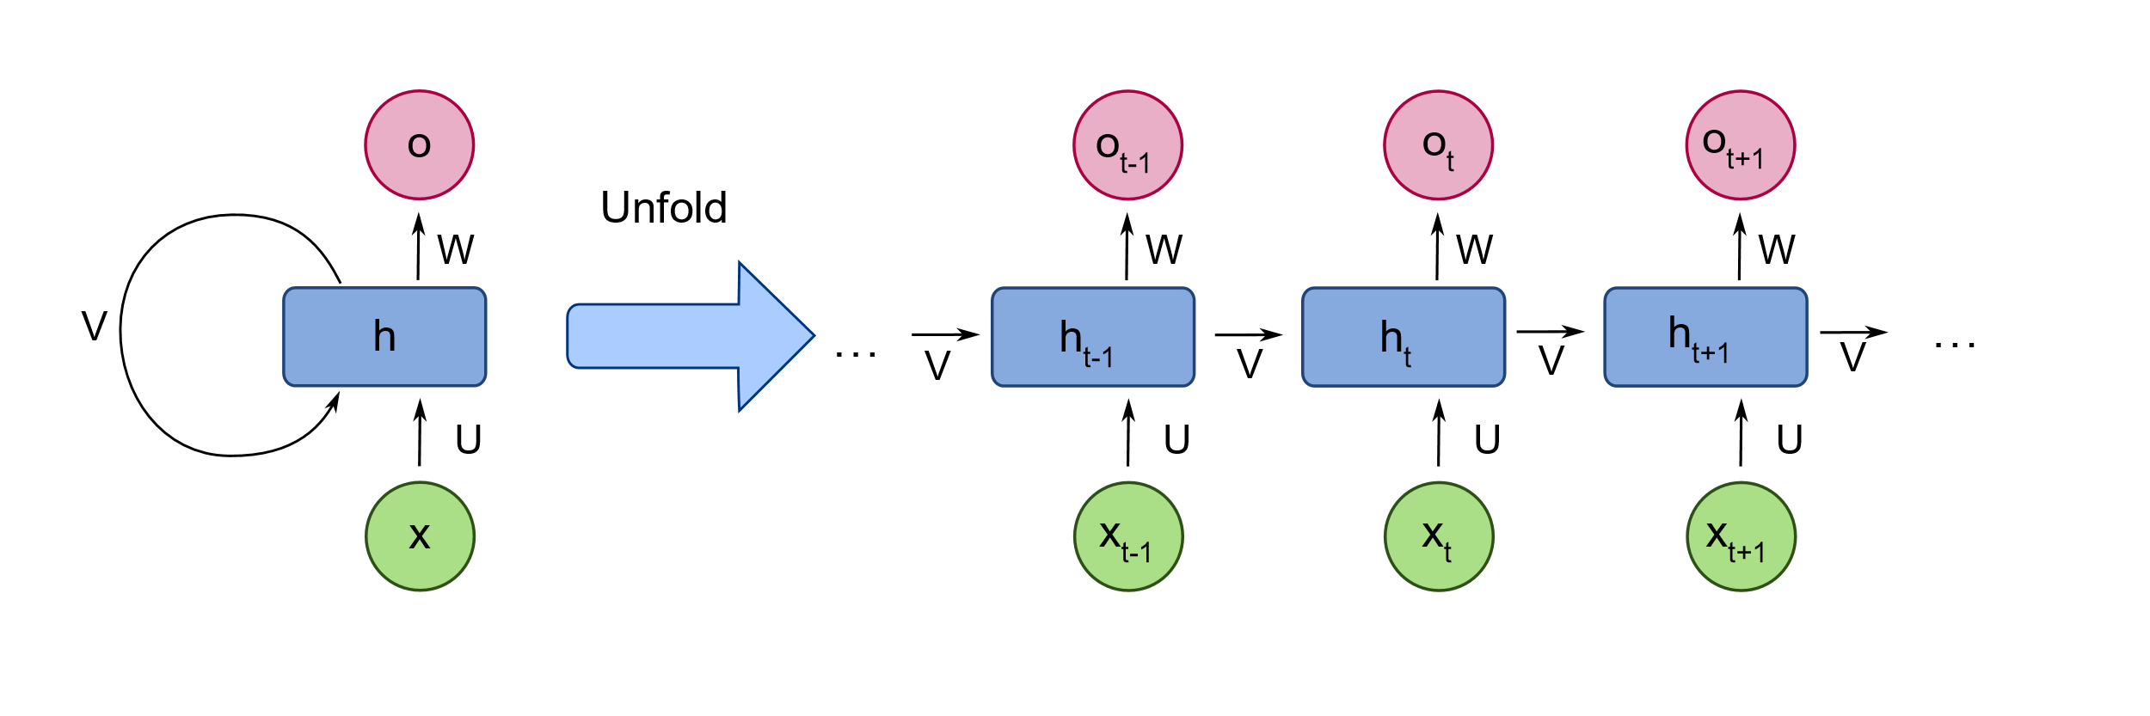
Rnn recap

Slide 4
Activation function
TAHN - is mainly used for classification between two classes. Both Tahn and Sigmoid functions
are used in feed-forward networks.

Slide 5
Activation function
TAHN - is mainly used for classification between two classes. Both Tahn and Sigmoid functions are used in feed-forward networks.
RELU - We learned in class.

Slide 6
Activation function
TAHN - is mainly used for classification between two classes. Both Tahn and Sigmoid functions are used in feed-forward networks.
RELU - We learned in class.
SELU - (Scaled Exponential Linear Units)

Slide 7
Selu (scaled exponential linear units)
keep the outputs normalized

Slide 8
Selu (scaled exponential linear units)
keep the outputs normalized
the normalization occurs inside the activation function.

Slide 9
Selu (scaled exponential linear units)
keep the outputs normalized
the normalization occurs inside the activation function.
A custom weight initialization technique is being used.

Slide 10

Selu (scaled exponential linear units)

Slide 11
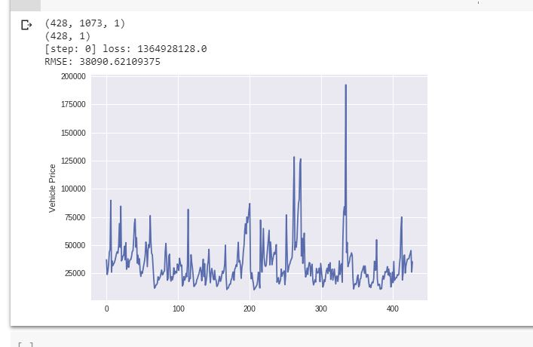
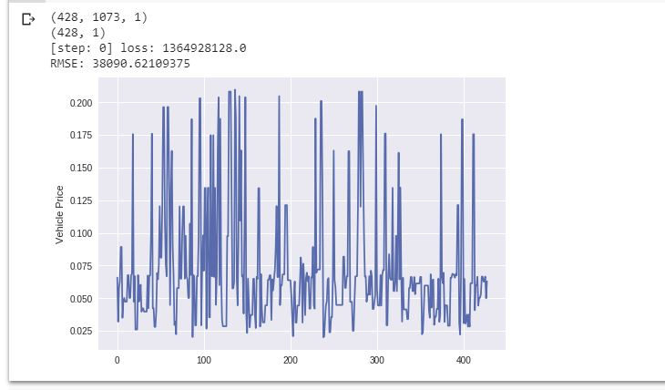
Results
*y test – how our data should have looked
*actual results from our program

Slide 12
Conclusion
Results not what we expected
Likely cause – not enough data

Slide 13
References
https://en.wikipedia.org/wiki/Recurrent_neural_network
https://towardsdatascience.com/activation-functions-neural-networks-1cbd9f8d91d6
https://towardsdatascience.com/selu-make-fnns-great-again-snn-8d61526802a9

